Slide 1
Making the most of the expertise of community pharmacists and the pharmacy team
Alastair Buxton
Director of NHS Services, PSNC
alastair.buxton@psnc.org.uk @ABuxtonPSNC

Slide 2
Community pharmacy services
Optimising the use of medicines
Supporting people to live healthier lives/public health
Supporting people
to self-care
Supporting people to live independently

Slide 3
The Community Pharmacy Team
Pharmacist
Medicines Counter Assistants / Healthcare Assistants / Health Champions
Dispensers
Registered Pharmacy Technicians
Delivery drivers

Slide 4
The NHS Community Pharmacy contract
Three tiers of service
Essential services – all pharmacies provide
Advanced services – all pharmacies can provide
Locally commissioned services
NHS income for a typical community pharmacy accounts for 85-95% of their total turnover

Slide 5
Essential services
Dispensing
Repeat Dispensing
Support for self-care
Signposting patients to other healthcare professionals
Healthy Lifestyles service (Public health)
Waste medication disposal
Clinical governance

Slide 6
Advanced services
Medicines Use Review (MUR)
High risk medicines / Post-discharge from hospital / Respiratory disease / Cardiovascular risk
Appliance Use Review
Stoma Appliance Customisation
New Medicine Service (NMS)
Asthma or COPD / Diabetes (Type 2) / Antiplatelet & Anticoagulant therapy / Hypertension
Seasonal Flu Vaccination Service
Consultation room requirement
Pharmacist competency requirements

Slide 7
Development of the NHS community pharmacy service…
Give patients access to urgent medication
Offer people advice at their own convenience, using pharmacy as a first port of call
Care for frail and older people
Support people to manage their long-term conditions more effectively
Help identify people with undiagnosed respiratory disease

Slide 8
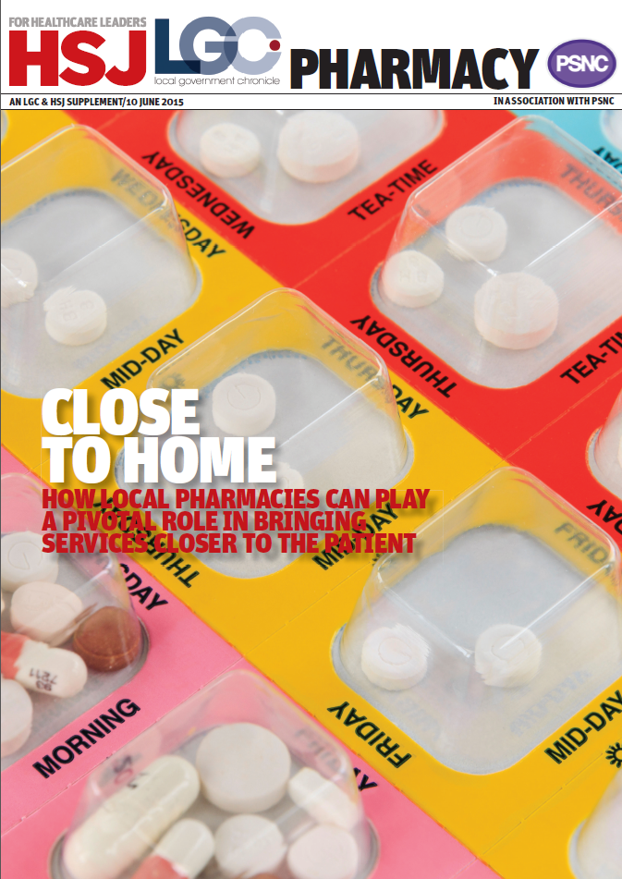
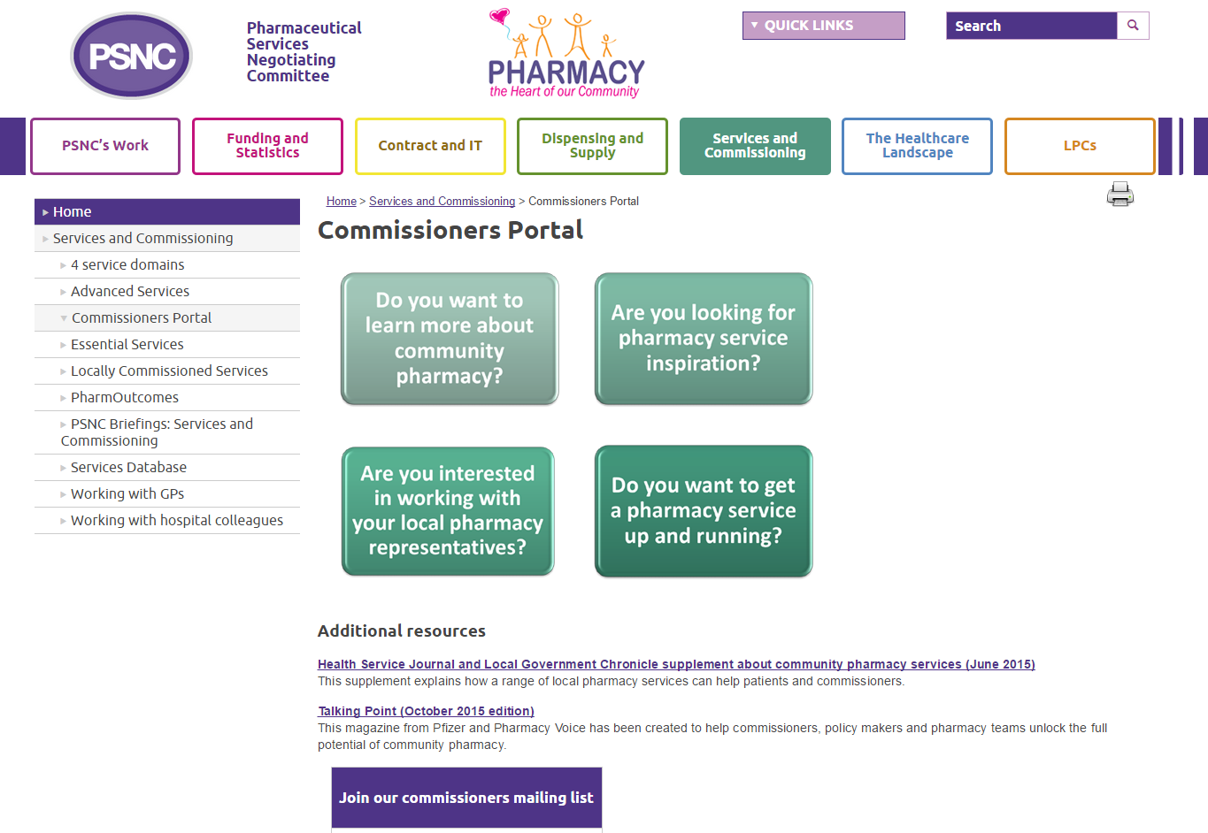
Service inspiration for commissioners…
www.psnc.org.uk/commissioners
Sign up for our commissioner emails

